Slide 1

Web Chat Application
Adarsh Prakash
BTech/15136/18
ECE
Guide: Dr. shiv Kumar Choubey

Slide 2
Introduction
In today’s world of almost no virtual privacy, and every tech companies trying to collect more and more data from the users, a web chat application which provides a safe and secure place to talk and promises to not save any of your chat history can be viewed as a great alternative.
Most social media sites have apps that ask for permission to access your account information before you can install them, as this is a web application, you can use this without the need to provide these permissions.
The objective of this project was to develop a chat application that can be used for chatting and image sharing with the added benefits of privacy
Notes:
(These don’t have designer IDs since they were based off the default master slides already in the deck.

Slide 3
Languages Used
Frontend
Backend
HTML(HyperText Markup Language)
CSS (Cascading StyleSheet)
JavaScript
Python (server side)
PostgreSQL (database)

Slide 4
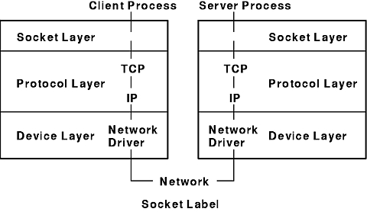
Working and Protocols
The data transfer protocol used in this application is network socket.
It is a bidirectional communication link between two programs running on a network, which in this case is between client and server.
Its advantages over HTTP methods is that it doesn’t need to request every time for new data, as over socket data both nodes can transmit and receive data continuously.

Slide 5
Working
Client side
User types the message and sends it.
Client side
The message is emitted using JavaScript.
Sever side
Client side
The client then receives the message and displays it to the user.
The server receives the message and then transmits it to the to all the members in that room.

Slide 6
Features
User registration.
Login Details encrypted.
Private Chat rooms.
Image sharing.
Real time text translation.
Responsive site.

Slide 7
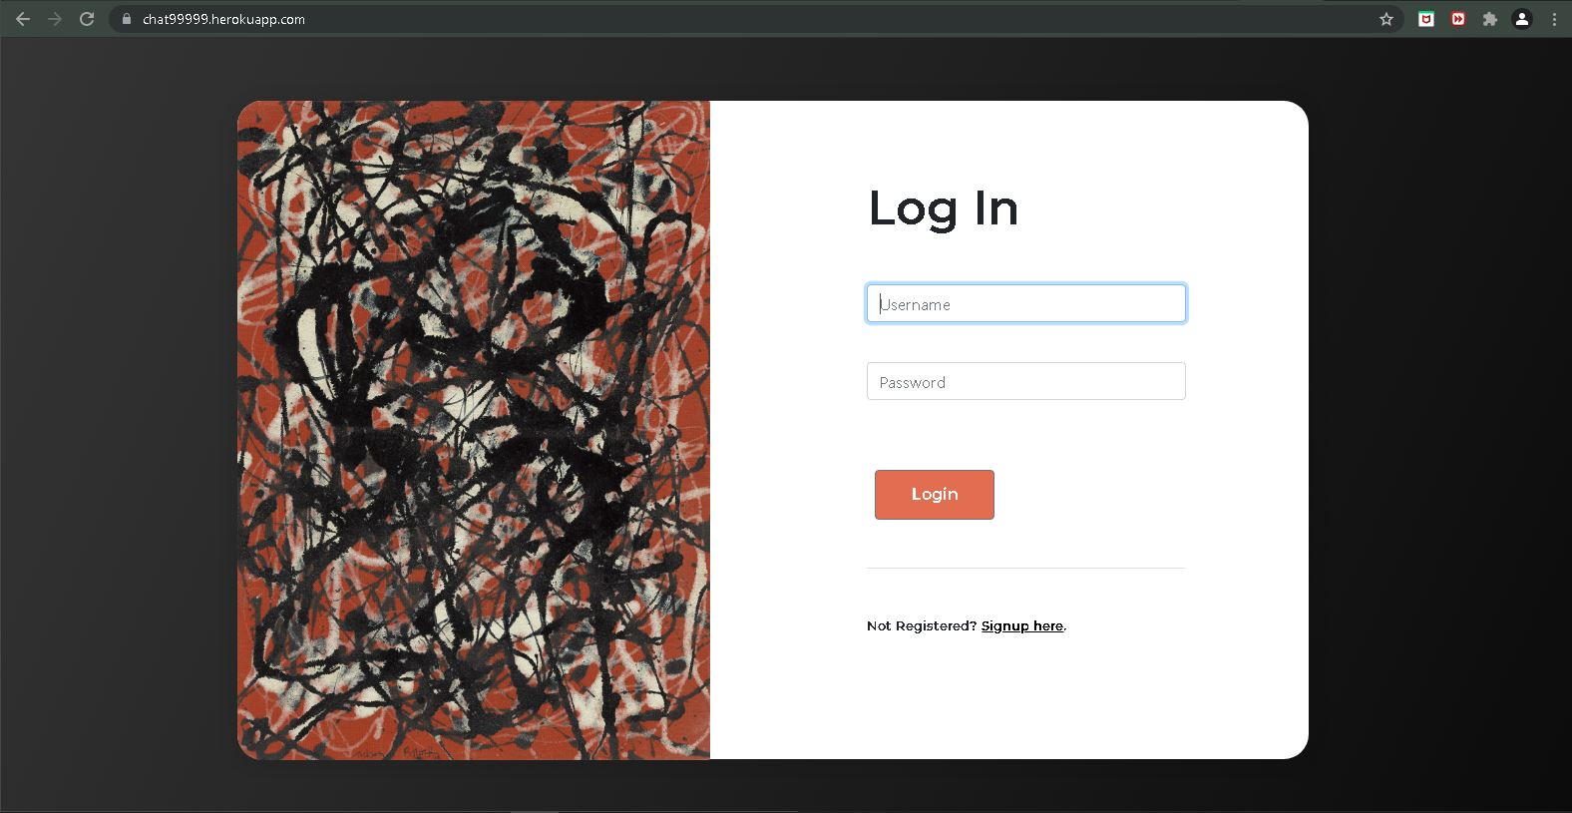
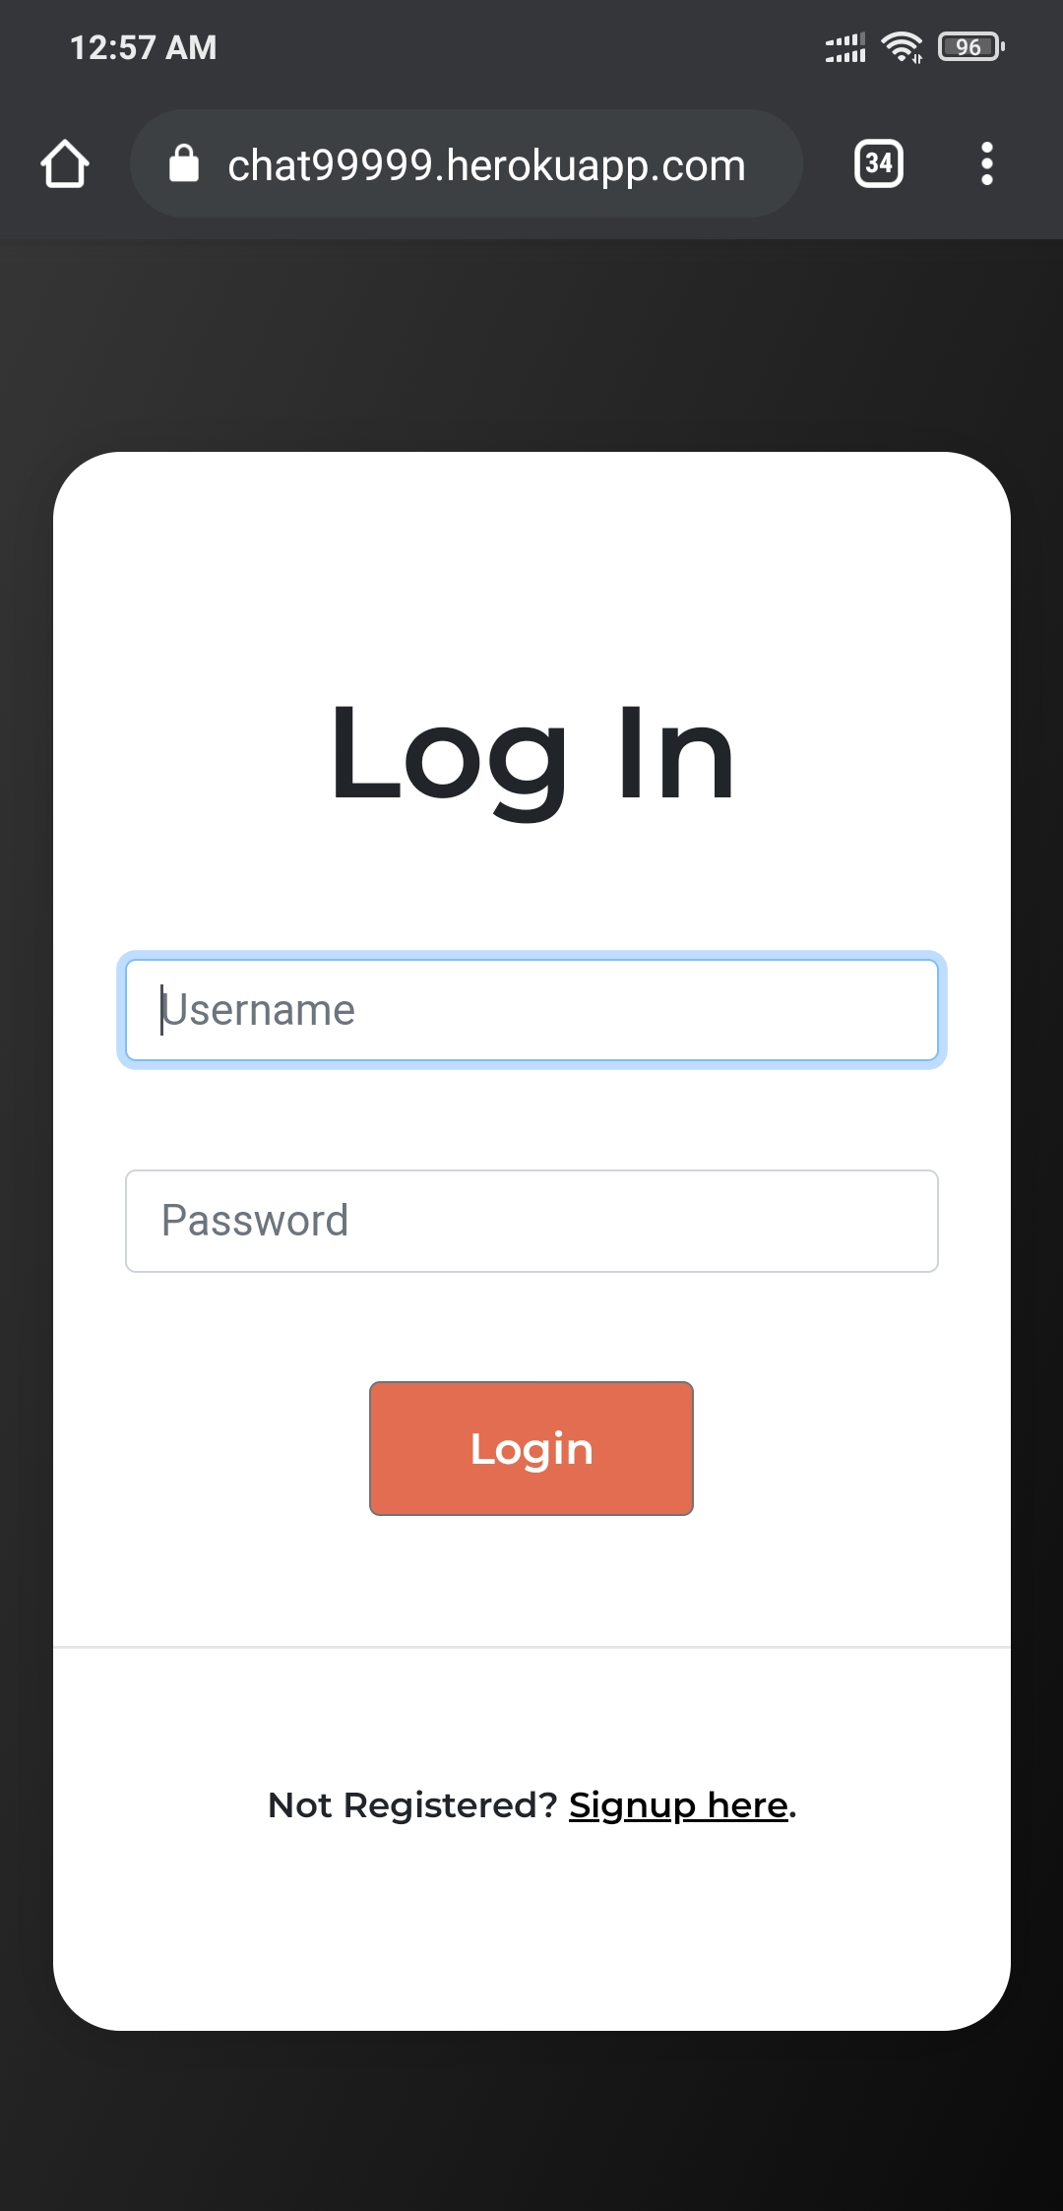
Screenshots
The Login Page

Slide 8
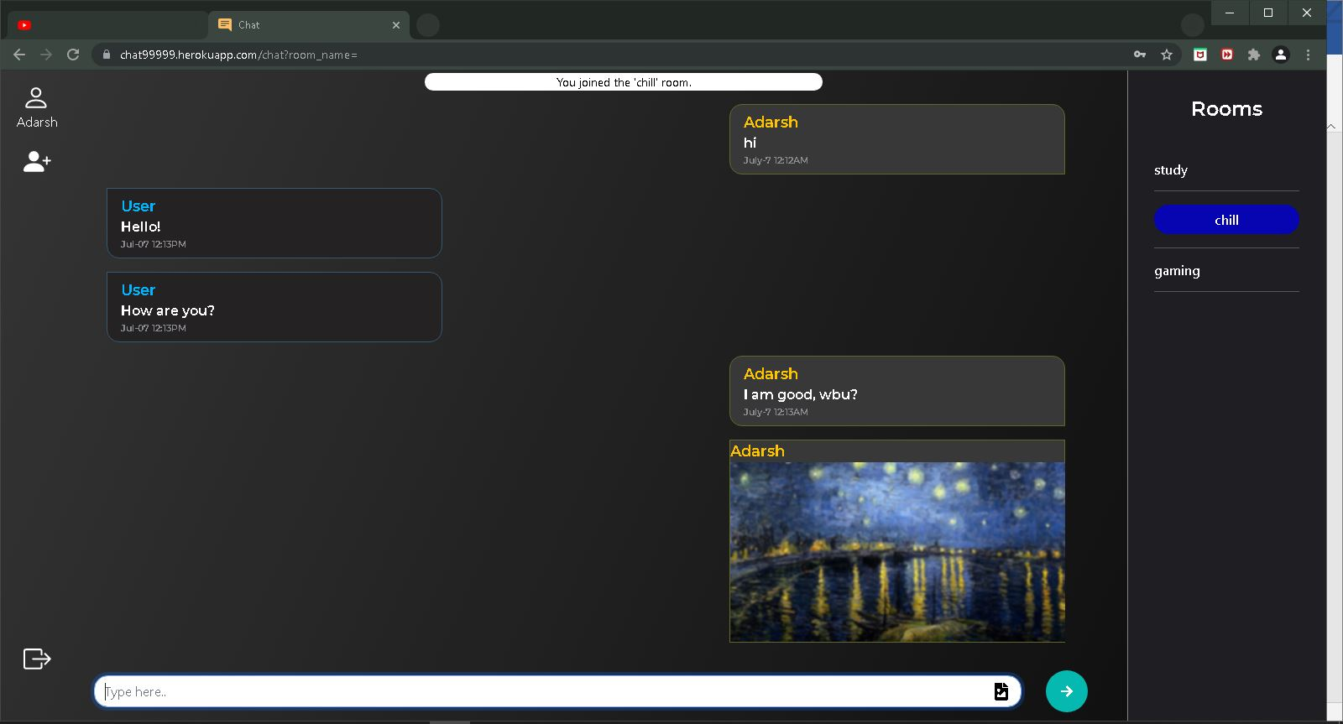
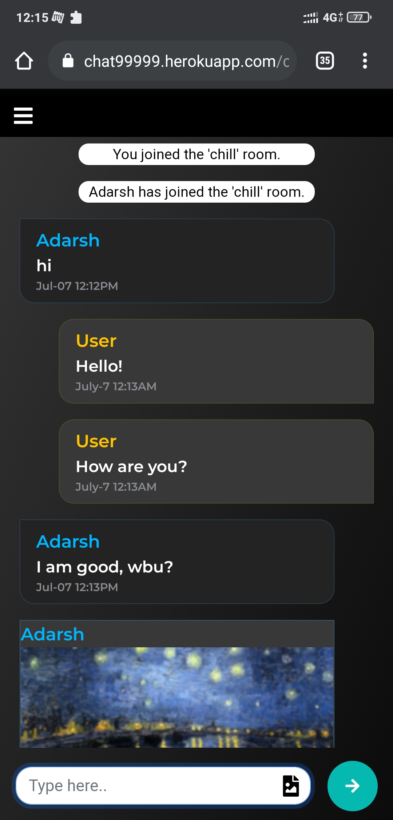
Screenshots
The Chat room page

Slide 9
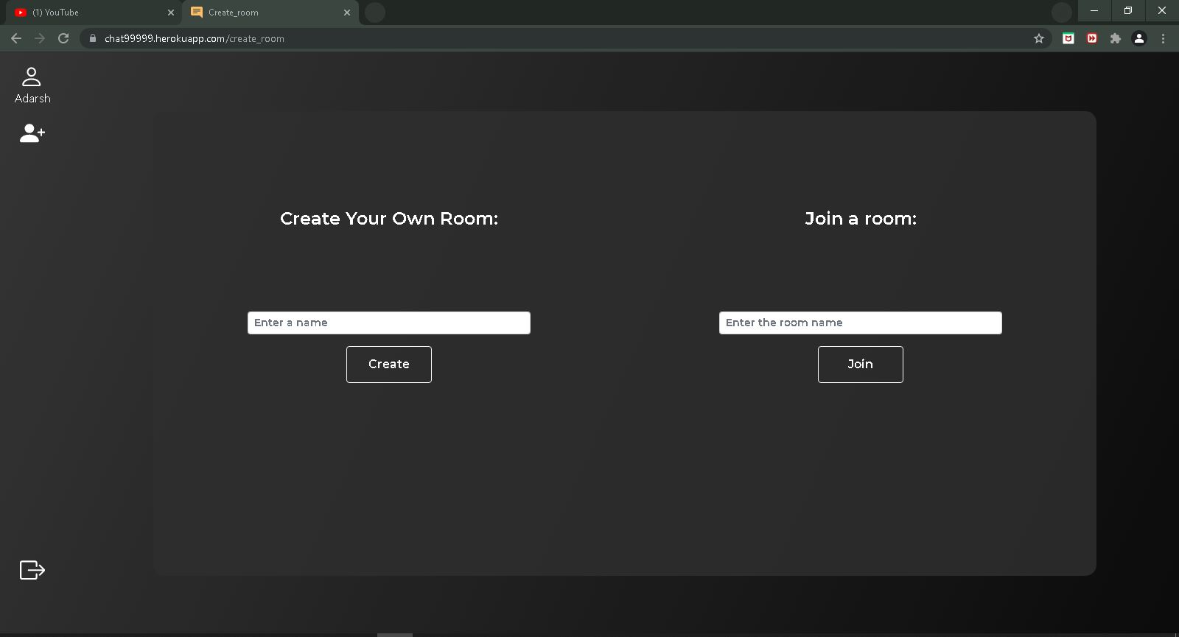
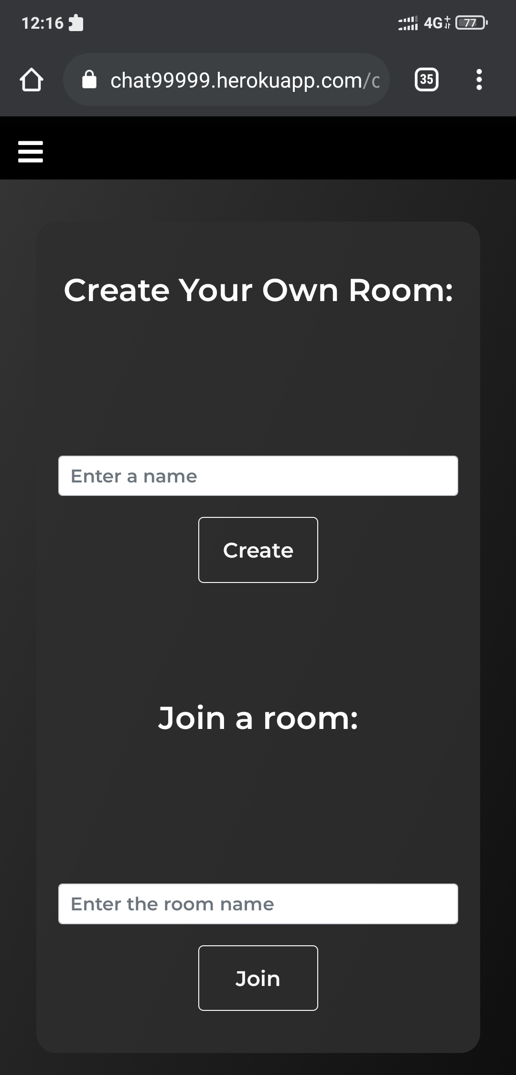
Screenshots
The Join room page

Slide 10
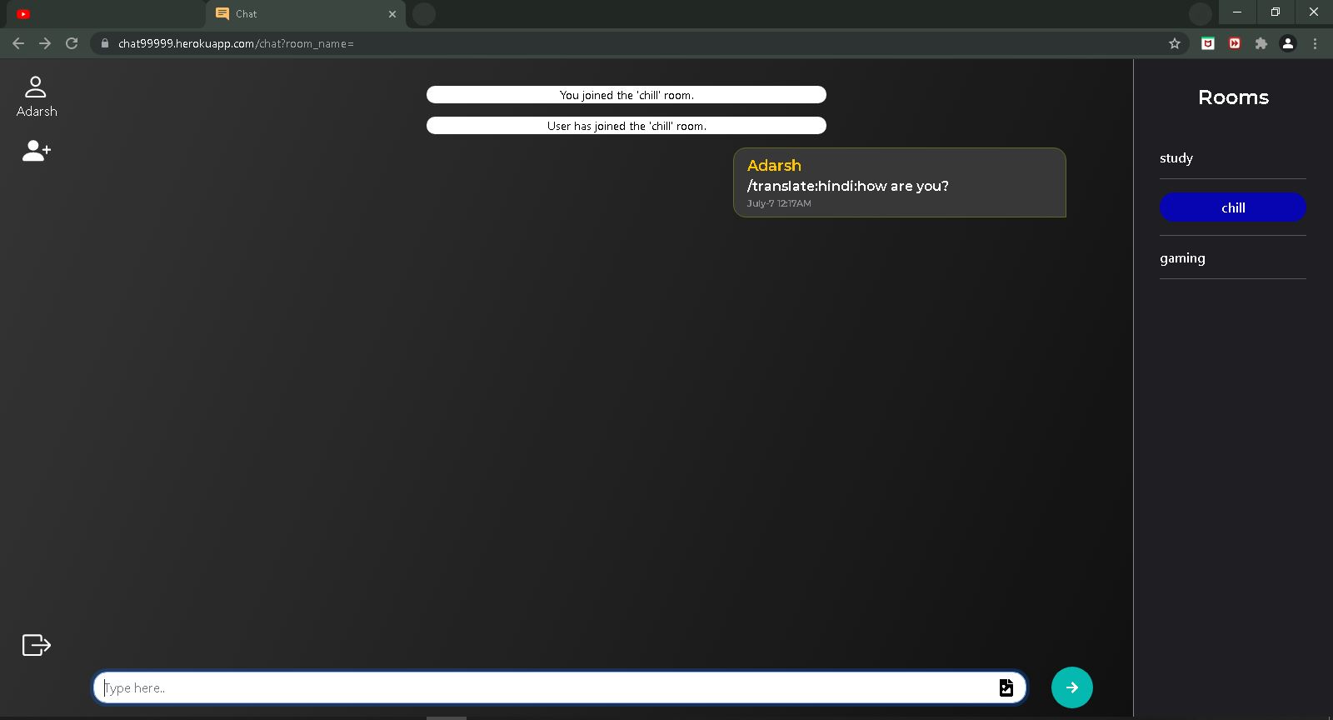
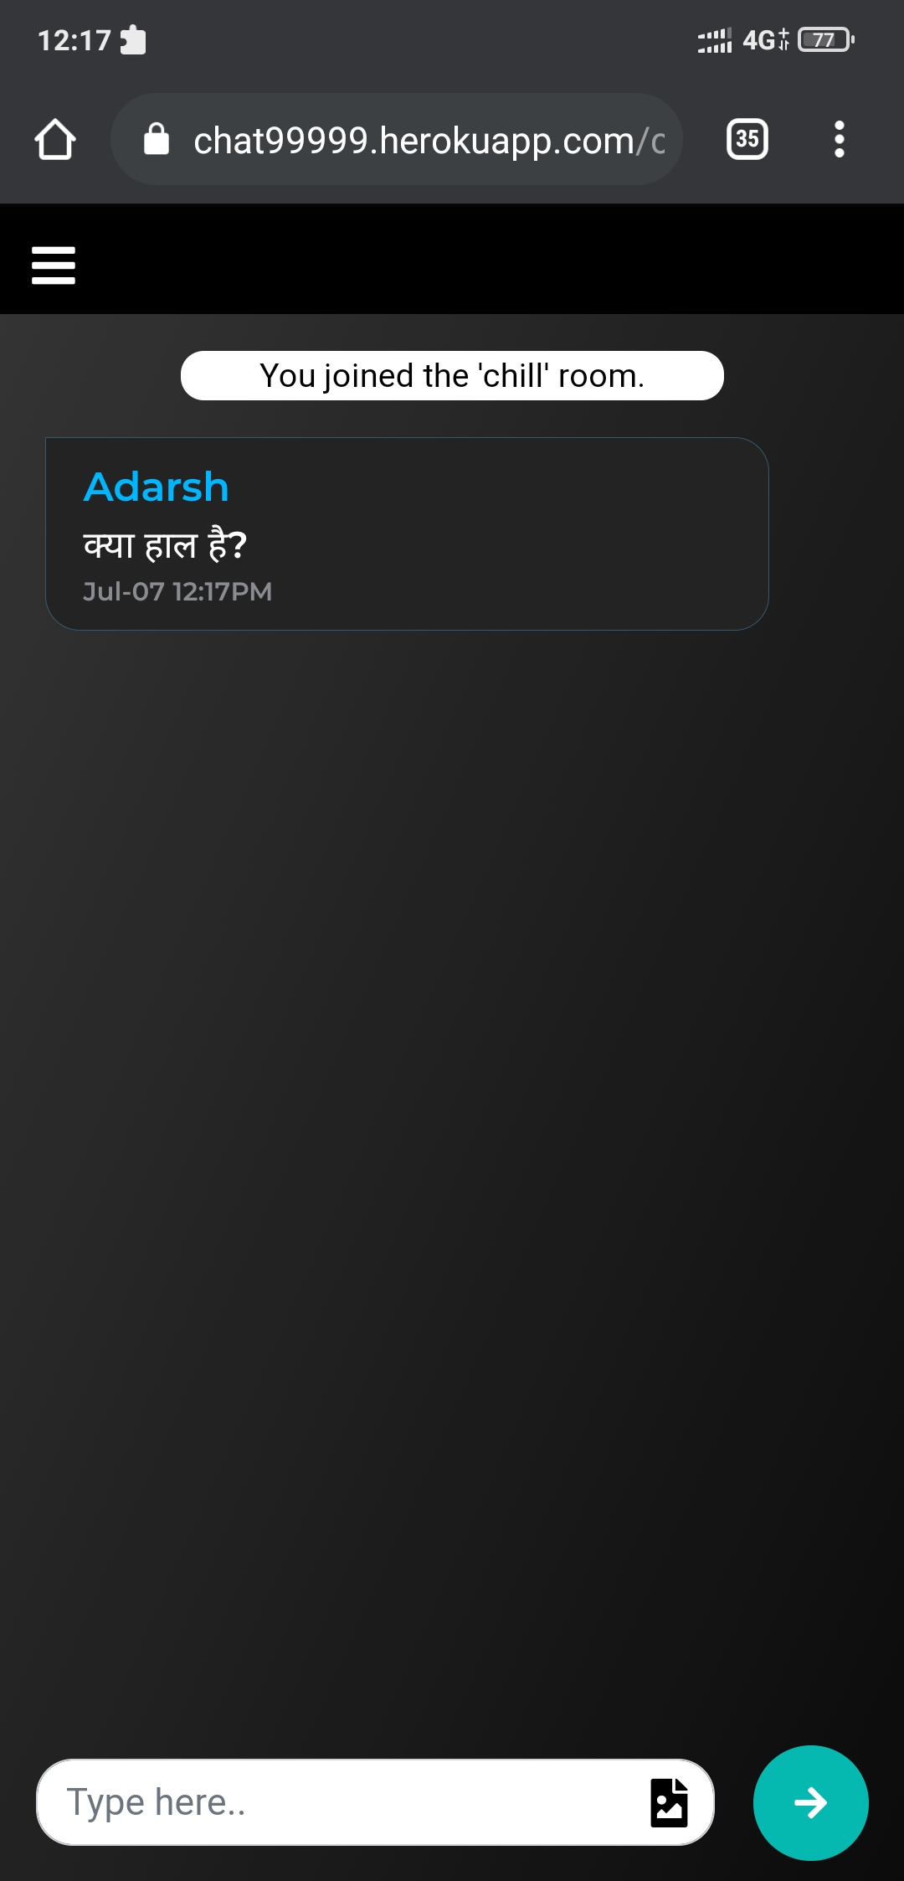
Screenshots
The Translation feature in action

Slide 11
Future Plans for the Project
Add the feature of storing messages so that users can see their past messages.
Add the feature of voice calling and video calling down the line.
Add the feature of sharing other files like videos, pdfs, text files, etc.
Add the feature where users can play music in rooms.

Slide 12
Conclusion
It is an alternative to other chat applications, with its advantages and disadvantages. In this world, where data privacy is getting a bigger and bigger priority, this application can provide an alternative.
The project exposed me to the latest technology in the area of web development, network protocols, and server hosting.
I also learnt working with database, data encryption.
This project also exposed me to the world of APIs, and how to integrate them to our projects.

Slide 13
References
Flask-ScoketIO documentation: https://flask-socketio.readthedocs.io/en/latest/
Flask documentation: https://flask.palletsprojects.com/en/2.0.x/
Googletrans documentation: https://py-googletrans.readthedocs.io/en/latest/
Bootstrap: https://getbootstrap.com/docs/4.1/getting-started/introduction/
Fontawesome: https://fontawesome.com/
Stackoverflow
google

Slide 14
Thank you

